Slide 1
CHAPTER 4
Research Ethics

Slide 2
Research Ethics in Psychology
Modern research is designed with the goal of protecting participants
Psychologists are bound by the same broad ethical principles as physicians and other clinicians
Psychological Research is governed by Institutional Review Boards (IRBs)

Slide 3
Research Ethics in Psychology
Ethics = principles that govern a person’s actions or behavior
Research Ethics = application of fundamental ethical principles to research activities

Slide 4
Chapter Outline
Historical examples
Ethical principles and practices
Animal research practices
Ethical decision making: A thoughtful balance

Slide 5
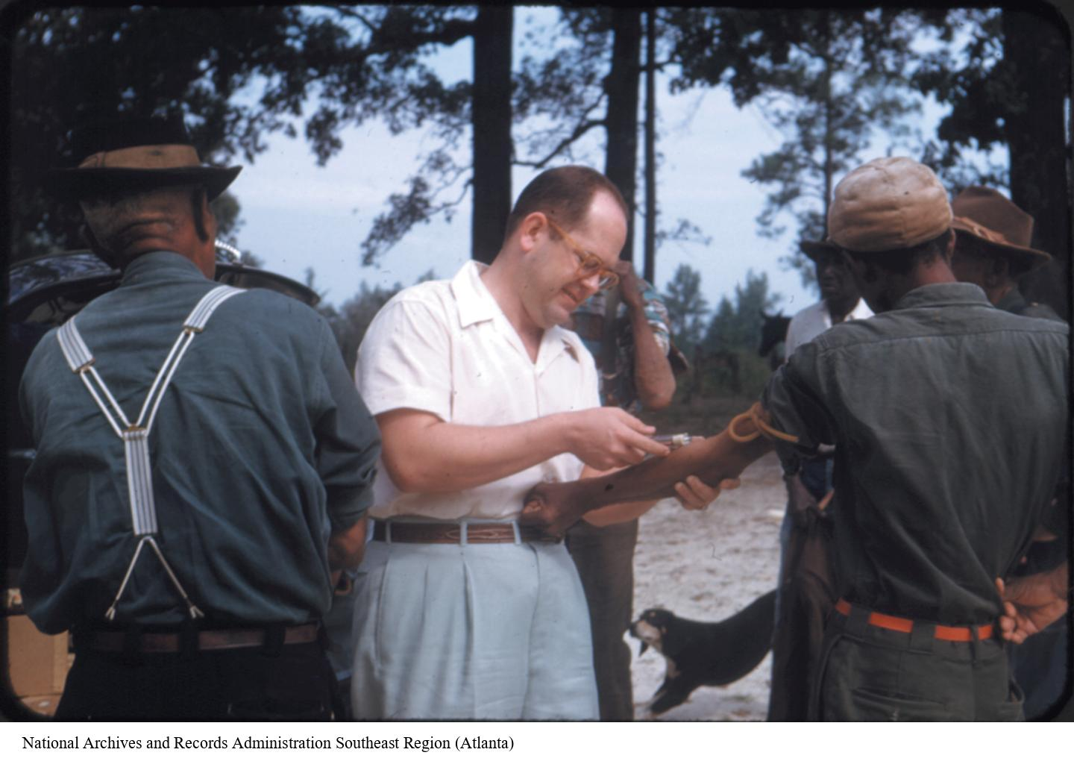
Historical Examples
The Tuskegee Syphilis Study illustrates three major ethics violations.
The Milgram obedience studies illustrate a difficult ethical balance.
Others!
Notes:
Figure 4.1: The Tuskegee Syphilis Study
A doctor takes a blood sample from a participant. What unethical decisions were made by the researchers who conducted this study?
The chapter highlights two historical examples relevant to the ethical treatment of human research participants. The Tuskegee Syphilis Study was a medical study on syphilis involving Black men in the 1930s. The Milgram obedience studies were psychological studies of obedience conducted in the 1960s. The chapter highlights two historical examples relevant to the ethical treatment of human research participants.
National Archives and Records Administration Southeast Region (Atlanta)

Slide 6
Landis (1924)
Goal: Match human facial expressions to specific emotions
Had participants engage in a variety of tasks designed to elicit specific emotions
    Listening to Jazz
    Reading scripture
    Smelling ammonia
    Sticking their hands in a bucket of live frogs (unaware of frogs)
    Fired a gun in close proximity to the subjects
    Exposed them to pornography
    Handed them a live rat, a knife, and asked subject to decapitate the rate
Notes:
Sometimes the frog bucket had a live electrical wire at the bottom
Confronted with this high-stress situation, some persons started crying, others hysterically laughed; some completely froze, others burst out into swearing.

Slide 7

The Tuskegee Syphilis Study Illustrates Three Major Ethics Violations
Unethical choices
    The participants were not treated respectfully.
    The participants were harmed.
    The participants were a targeted, disadvantaged social group.
Notes:
Figure 4.2: Acknowledging Tuskegee
Fred Gray was the civil rights attorney who represented men who participated in the study. His work resulted in a $10 million settlement for the men and their families. He is pictured in his office in Alabama.
The text does an excellent job of summarizing the Tuskegee Syphilis Study, and there are also many videos about the study available online. These are the three kinds of ethics violations in the research.
The participants were not treated respectfully. They were not told whether or not they had syphilis, were not informed about cures that became available during the course of the study, may have felt coerced to participate because of the generous burial fee provided to families, and did not provide informed consent for their participation.
The participants were harmed. In particular, they were not told about penicillin as a treatment for syphilis, which would have cured those who were infected. Many of the men in the study could not read and so were unlikely to even learn of this treatment. Moreover, some of the tests participants underwent were painful and potentially dangerous (e.g., spinal taps).
3. The participants were a targeted and disadvantaged social group. The men in this study were Black and poor, even though people from all races and socioeconomic backgrounds were affected by syphilis at the time.
© Mickey Welsh-USA TODAY NETWORK

Slide 8


Slide 9
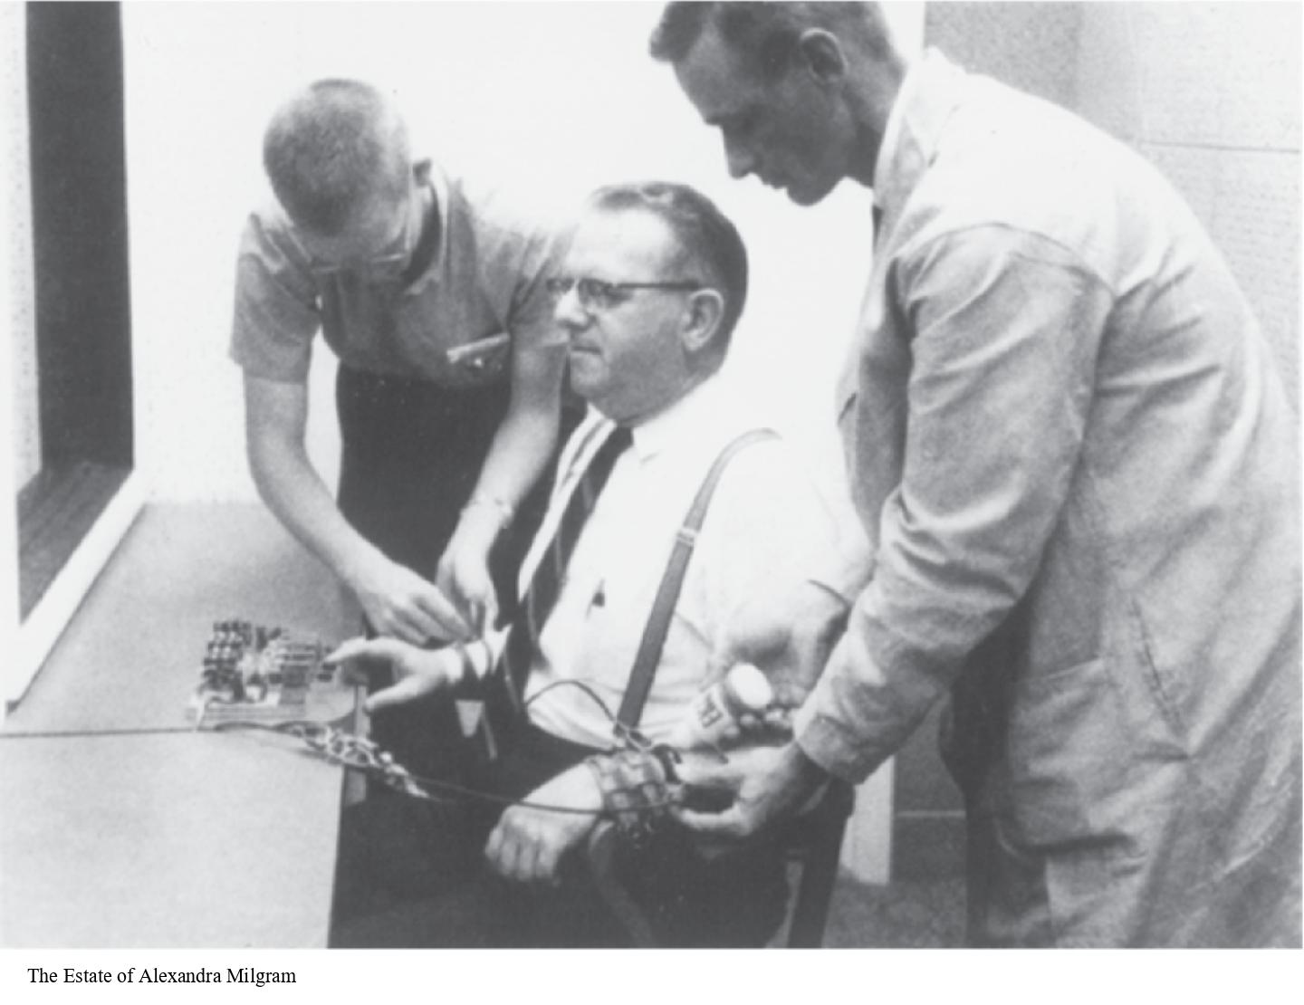
The Milgram Obedience Studies Illustrate a Difficult Ethical Balance
Ethical questions
        Debriefing
Balancing risk to participants with the benefit to society
Notes:
Figure 4.3: The Milgram Obedience Studies
In one version, the experimenter (right) and the true participant, or “teacher” (left), help connect the “learner” to the electrodes that would supposedly shock him. Was it ethical for the researchers to invent this elaborate situation, which ultimately caused participants so much stress?
The Tuskegee Syphilis Study clearly demonstrates some ethical violations. However, making ethical decisions is not always so clear-cut. Stanley Milgram’s studies of obedience to authority, conducted in the 1960s, exemplify how ethical decision making involves striking a balance. Most psychology students are familiar with Milgram’s studies from Introduction to Psychology or social psychology classes, and the text does a good job of describing Milgram’s research. There are also a number of videos available on the Internet that you could show in class to remind students of their studies.
Ethical questions: (1) Was it ethical to put teacher-participants through such a stressful experience? (2) Were there any lasting effects of the study after participants had been debriefed (informed that they did not actually shock the learner)? Some participants reported that even though following the debriefing they understood that they did not actually harm anyone, they still thought about the fact that they were willing to harm another individual for a long time afterward.
Balancing risk to participants with benefit to society: The results of Milgram’s studies were surprising in that 65% of participants obeyed the experimenter and shocked learners at the highest levels. But after this was found, could the procedures have been adjusted in some way to minimize participants’ anxiety? Researchers need to strike a balance between conducting research that is ethical while also considering what the research contributes to and what society can learn from it. What are the risks to participants versus the value of the knowledge gained from the research?
The Estate of Alexandra Milgram

Slide 10

The Stanford Prison Experiment (1971)
Simulated a prison environment
  Individuals randomly selected to be “guards” or “prisoners”
  Given uniforms, fully thrown into roles
  “Guards” engaged in all sorts of psychological abuse towards “prisoners”

Slide 11
National Research Act (1974)
Established regulations designed to protect human participants in research.
Created institutional review boards (IRBs) to ensure that the welfare of participants is adequately protected

Slide 12

Protecting Participants
Institutional Review Boards
  A panel of faculty who review all research proposals involving human subjects
  Guarantees that subjects’ rights/interests are protected.
https://msutexas.edu/irb/

Slide 13
Protecting Participants
Key Guidelines:
  Informed Consent:
    Participants know what they’re getting into and that they can quit the study at any time
  Confidentiality:
    Responses can’t be traced back to any one person
  Debriefing:
    Participants are told true purpose of study
    Extra important when deception is used!

Slide 14
Informed Consent
Informed consent ensures Voluntary Participation
  No one can be forced to participate.
  Participants should be free to quit a study at any time
  Participants must consent before they can start the study!

Slide 15
Protecting Participants
What does the IRB look for?
  Who are the participants? Are they from a vulnerable population? (children, prisoners, etc.)
  Will participants be harmed by participating?
  Is deception used? If so, are participants debriefed?
  How are participants compensated? How is consent given? Are they being coerced into taking the study?

Slide 16

Three Core Principles
  The Belmont Report: Principles and applications
    Principle of respect for persons
      Informed consent
    Principle of beneficence or concern for welfare
      Assess potential harm to participants and potential benefits to society.
    Principle of justice
      Who bears the burden of research participation?
Notes:
Figure 4.5: Vulnerable Populations in Research
Why might children be considered a vulnerable population that requires special ethical consideration?
Belmont Report: There are formal statements of ethics guidelines developed by organizations around the world. In the United States, the Belmont Report (1976) was created to define the ethical guidelines that should be followed by researchers in a variety of disciplines, including psychology. The Belmont Report outlines three main principles for conducting ethical research: respect for persons, beneficence, and justice.
The principle of respect for persons: This principle has two parts.
Research participants should be free to decide for themselves whether they would like to participate in a study. In other words, participants are entitled to informed consent (information about the risks and benefits of the research), so that they can decide whether to participate in an informed manner. This includes not coercing participants to participate in research in order to receive large incentives or avoid suffering negative consequences.
Certain groups of people are less autonomous and are entitled to special protection in terms of informed consent. These individuals include children, people with cognitive disabilities, and prisoners. Sometimes these people may be unable to give informed consent (e.g., children), so informed consent will be obtained from a parent or guardian.
The principle of beneficence: The word beneficence refers to doing good. The principle of beneficence states that researchers need to take measures to protect participants from harm and ensure their well-being. This includes researchers weighing risks and benefits of their research, and also considering who might benefit from the research and who might be harmed.
Physical harm and physical benefits are easier to assess than psychological harm and psychological benefits. How was this principle violated in the Tuskegee Syphilis Study? What about in Milgram’s studies? In terms of benefits of research to the community, it’s not always easy to quantify harm and benefits in terms of lives or dollars.
Anonymous study: researchers do not collect any potentially identifying information (e.g., names, photos, birthdays).
Confidential study: researchers collect some identifying information but prevent it from being disclosed.
The principle of justice: This principle looks at the balance between those who participate in the research and those who benefit from it: Who bears the risk and who reaps the benefits? Apply this principle to the Tuskegee Syphilis Study.
Voisin/Phanie/Science Source

Slide 17
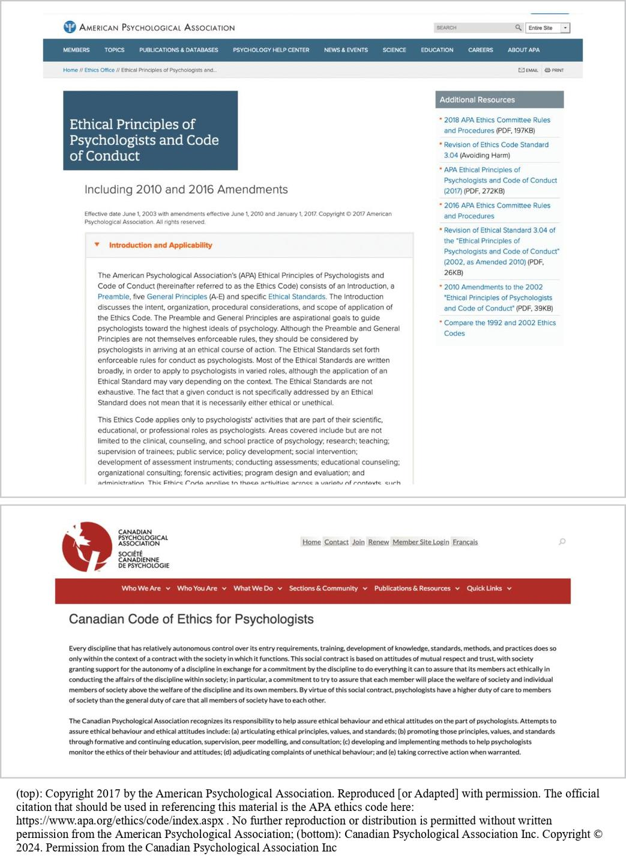
Guidelines for Psychologists: APA Ethical Principles
Notes:
Figure 4.6: APA and CPA Websites
The full text of the APA and CPA the APA ethics code here: https://www.apa.org/ethics/code/index.aspx . No further reproduction or distribution is permittethical principles can be found on their websites. If you are considering becoming a therapist or counselor someday, you may find it interesting to read the ethical standards that were written specifically for practitioners.
(top): Copyright 2017 by the American Psychological Association. Reproduced [or Adapted] with permission. The official citation that should be used in referencing this material is ed without written permission from the American Psychological Association; (bottom): Canadian Psychological Association Inc. Copyright © 2024. Permission from the Canadian Psychological Association Inc

Slide 18
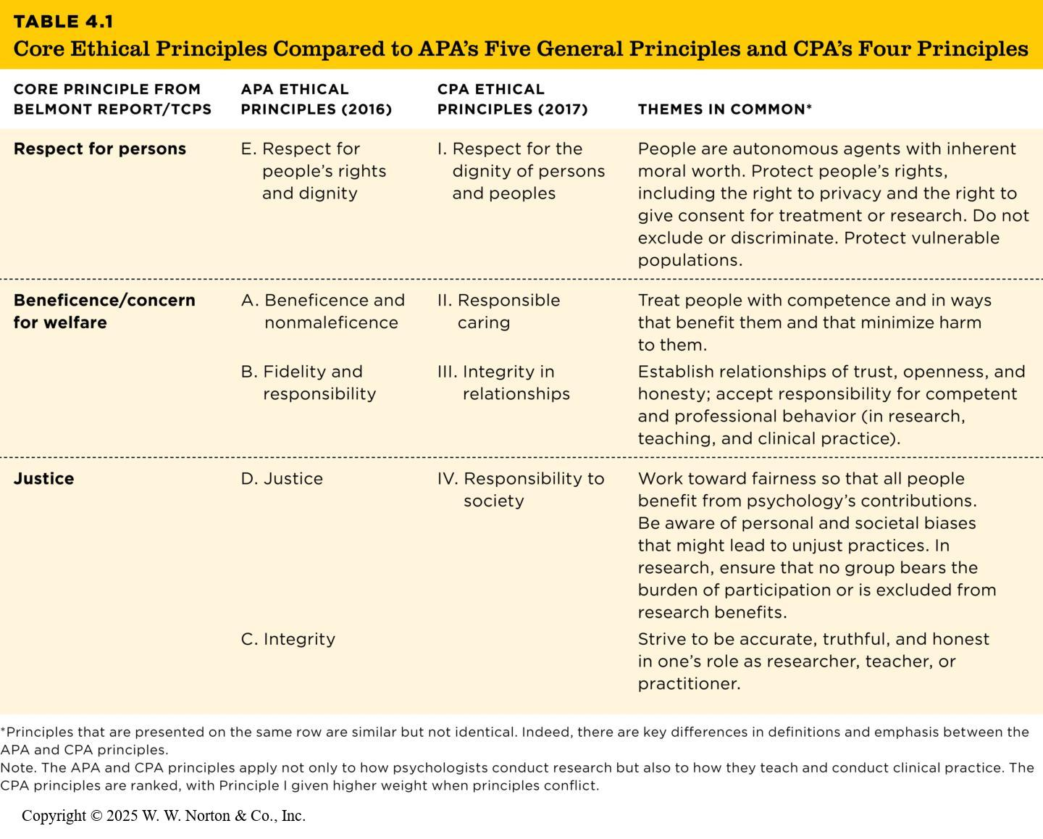
Belmont Plus Two: APA’s Five General Principles
Table 4.1
Table 4.1 Core Ethical Principles Compared to APA’s Five General Principles and CPA’s Four Principles
Core Principle from Belmont Report/TCPS | APA Ethical Principles (2016) | CPA Ethical Principles (2017) | Themes in Common*
Respect for persons | E. Respect for people’s rights and dignity | I. Respect for the dignity of persons and peoples | People are autonomous agents with inherent moral worth. Protect people’s rights, including the right to privacy and the right to give consent for treatment or research. Do not exclude or discriminate. Protect vulnerable populations.
Beneficence/concern for welfare | A. Beneficence and nonmaleficence | II. Responsible caring | Treat people with competence and in ways that benefit them and that minimize harm to them.
 | B. Fidelity and responsibility | III. Integrity in relationships | Establish relationships of trust, openness, and honesty; accept responsibility for competent and professional behavior (in research, teaching, and clinical practice).
Justice | D. Justice | IV. Responsibility to society | Work toward fairness so that all people benefit from psychology’s contributions. Be aware of personal and societal biases that might lead to unjust practices. In research, ensure that no group bears the burden of participation or is excluded from research benefits.
 | C. Integrity |  | Strive to be accurate, truthful, and honest in one’s role as researcher, teacher, or practitioner.
Principles that are presented on the same row are similar but not identical. Indeed, there are key differences in definitions and emphasis between the APA and CPA principles.
Note. The APA and CPA principles apply not only to how psychologists conduct research but also to how they teach and conduct clinical practice. The CPA principles are ranked, with Principle I given higher weight when principles conflict.
Notes:
Table 4.1: Core Ethical Principles Compared to APA’s Five General Principles and CPA’s Four Principles
Principles that are presented on the same row are similar but not identical. Indeed, there are key differences in definitions and emphasis between the APA and CPA principles.
Note. The APA and CPA principles apply not only to how psychologists conduct research but also to how they teach and conduct clinical practice. The CPA principles are ranked, with Principle I given higher weight when principles conflict.
Copyright © 2025 W. W. Norton & Co., Inc.

Slide 19
Ethical Practices for Psychologists
Ethical standards for research common to the APA
  Ethics training
  Institutional review boards, research ethics boards
  Informed consent
  Deception
  Debriefing
  Research misconduct
    Data fabrication and data falsification
    Ethics of openness and transparency
    Plagiarism, including self-plagiarism
  Animal research
Notes:
The APA also has 10 specific ethical standards. Of these 10 standards, Ethical Standard 8 is most relevant for psychologists as researchers. Let’s examine the details of the standard.
Institutional review board (IRB): These boards are responsible for making sure that research using humans as participants is conducted ethically.
Informed consent: Explanation of the study must be provided in a written format before a person agrees to participate; the participant signs two forms (keeping one and giving the other to the researcher).
Deception: There are two types of deception—omission (withholding details of the study from participants) and commission (lying to participants).
Debriefing: When researchers use deception, they must debrief participants following their participation. Debriefing sessions are typically conducted verbally, and the researcher explains why deception was used and the nature of the deception.
Research misconduct: Data fabrication (researchers invent data that fit their hypotheses) and data falsification (researchers selectively delete observations or influence participants to act in a particular way). Plagiarism is representing the words or ideas of others as your own. Remember to cite your sources in order to avoid plagiarism.
Animal research: Some psychologists conduct research on nonhumans (e.g., insects, primates, or rodents), and we need to make sure that these animals are treated well and protected from suffering. (See the next slide for details.)
Plagiarism: usually defined as representing the ideas or words of others as one’s own. When researchers publish multiple articles in a line of research, they should also be careful not to self-plagiarize or recycle sections of text from their own previous articles.

Slide 20
Animal Research Practices
Purpose of animal research
    Test hypotheses unethical to study in humans
Ethical considerations
    Balance human benefits with animal welfare
    Prevent unnecessary suffering
Notes:
In psychology and other scientific disciplines, a significant amount of research is conducted using animal subjects, including rats, mice, cockroaches, birds, sea snails, dogs, and macaques. Animal research provides opportunities to test hypotheses that cannot be ethically explored with human subjects.

Slide 21
Examples of Animal Research (1)
Harlow’s Studies (1950s–60s)
Notes:
Harlow’s studies on attachment and social deprivation in monkeys were groundbreaking but highly controversial. These experiments demonstrated the importance of social bonds for healthy cognitive and social development. For instance, Harlow tested whether baby monkeys would prefer a wire mother that provided food or a cozy cloth mother that offered comfort. However, his methods involved severe deprivation, such as isolating baby monkeys from their mothers and raising them in sterile environments. In one infamous experiment, monkeys were placed in “pits of despair,” steel chambers designed to model depression. While these studies provided critical insights into the importance of attachment, they also caused significant suffering to the animals. Today, such methods would not be approved due to stricter ethical regulations governing animal research.
In contrast to Harlow's methods, modern research, such as studies by Lattin et al. on songbirds, prioritizes ethical considerations. These studies investigate how birds respond to stressors like captivity in breeding programs or ingesting small amounts of oil, both of which are caused by human activities. The researchers follow contemporary ethical practices, such as using minimal numbers of birds, employing anesthesia for invasive procedures, and exposing birds to only tiny amounts of contaminants (e.g., 1% oil in food). The goal of this research is not only to understand bird behavior but also to create solutions that support endangered species. By ensuring the welfare of the animals, these studies exemplify how impactful research can align with ethical standards.

Slide 22
The Pit of Despair
Harlow’s “Pit of Despair” (1970’s)
  Goal: Produce an animal model of depression
  Placed young monkeys that had already bonded w/ mother in isolation chambers
    Spent up to ten weeks in the chamber!

Slide 23

Pit of Despair: Findings
Most monkeys assumed a “hunched position” in the bottom corner of the chamber
All monkeys were thought so succumb to some sense of hopelessness
After removal, monkeys never reverted to their former states

Slide 24

Martin Seligman: Learned Helplessness
(1967)

Slide 25
Examples of Animal Research (2)
Songbird Research (Lattin et al., 2012, 2014)
Notes:
Harlow’s studies on attachment and social deprivation in monkeys were groundbreaking but highly controversial. These experiments demonstrated the importance of social bonds for healthy cognitive and social development. For instance, Harlow tested whether baby monkeys would prefer a wire mother that provided food or a cozy cloth mother that offered comfort. However, his methods involved severe deprivation, such as isolating baby monkeys from their mothers and raising them in sterile environments. In one infamous experiment, monkeys were placed in “pits of despair,” steel chambers designed to model depression. While these studies provided critical insights into the importance of attachment, they also caused significant suffering to the animals. Today, such methods would not be approved due to stricter ethical regulations governing animal research.
In contrast to Harlow's methods, modern research, such as studies by Lattin et al. on songbirds, prioritizes ethical considerations. These studies investigate how birds respond to stressors like captivity in breeding programs or ingesting small amounts of oil, both of which are caused by human activities. The researchers follow contemporary ethical practices, such as using minimal numbers of birds, employing anesthesia for invasive procedures, and exposing birds to only tiny amounts of contaminants (e.g., 1% oil in food). The goal of this research is not only to understand bird behavior but also to create solutions that support endangered species. By ensuring the welfare of the animals, these studies exemplify how impactful research can align with ethical standards.

Slide 26
Legal, Institutional, and Moral Frameworks
Legal, institutional, and moral frameworks
Legal protections for laboratory animals
Animal care guidelines and the three R’s
    Replacement
    Refinement
    Reduction
Moral frameworks
    Social benefit
    Animal welfare
Notes:
In the United States, the Animal Welfare Act (AWA, 1966) outlines standards for the ethical treatment of animals in research, although it excludes commonly studied species like mice, rats, and birds. Researchers must also comply with local and institutional requirements. Every research institution must have an Institutional Animal Care and Use Committee (IACUC) in the United States or an Animal Care Committee (ACC) in Canada. These committees, composed of veterinarians, scientists, community members, and students, approve research protocols before projects begin, ensuring animal welfare and scientific justification. They monitor compliance throughout the research process and have the authority to halt experiments or withdraw funding for violations. Similar regulations exist in European countries, emphasizing ethical oversight of animal research.
Research practices must adhere to the three Rs outlined by Russell and Burch (1959):
Replacement: Use alternatives like computer simulations or cell cultures when feasible.
Refinement: Modify procedures to minimize or eliminate distress to animals.
Reduction: Use the smallest number of animals necessary to achieve valid results.
Guidelines also specify standards for animal housing, diet, and environmental enrichment to ensure proper care, especially for social species. These measures help protect animals while allowing meaningful research to proceed responsibly.
Ethical considerations in animal research extend beyond regulations and the three Rs. Many animals, as demonstrated by the Cambridge Declaration of Consciousness (2012), are sentient and capable of experiencing pain, emotion, and consciousness. Modern frameworks, such as those proposed by DeGrazia and Beauchamp (2019), emphasize two core values: social benefit and animal welfare.
Social Benefit: Research must provide significant and likely benefits, such as advancing knowledge or improving human and animal health. It should only be conducted if no alternatives exist and if the expected benefits justify potential harm.
Animal Welfare: Sentient animals must not experience unnecessary harm. Their basic needs for food, housing, and social engagement must be met, and there should be limits on the severity and duration of harm. If extreme suffering is unavoidable, the research should not proceed.
By integrating legal, practical, and moral considerations, researchers strive to balance advancing science with protecting animal welfare. This evolving approach reflects a broader societal commitment to ethical responsibility in scientific research.

Slide 27
Ethical Decision Making: A Thoughtful Balance
Ethical decision making requires a balance of priorities.
We need to weigh the potential harm to human or animal participants against what the knowledge gained from the research will contribute to society.
Notes:
Ethical decision making is not a black-and-white process of saying that a study is or is not ethical. It is far more nuanced than that. The practice of ethical research practice is an ongoing and dynamic process of balance.

